Slide 1
18. Artificial Neural Networks
CSCI 561 Foundation for Artificial Intelligence
Professor Wei-Min Shen
University of Southern California

Slide 2
Outline
General Artificial Neural Networks and How They “Learn”
Basic Units, Perceptron, Multiple-Layers
Back Propagation Algorithm (minimizing the errors)
Modeling the Brain (very ambitious)
Deep Learning Neural Networks
See more details in
This week extra slides
Next week’s discussion
Applications

Slide 3
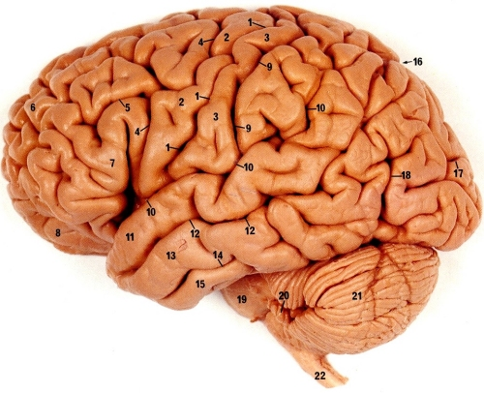
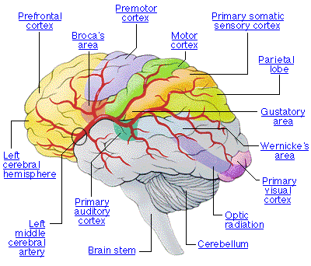
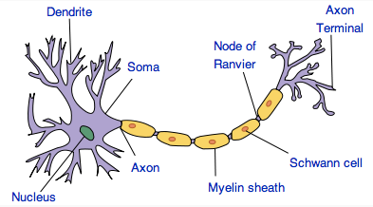
Neural Networks in Brain
Human brain is divided into regions with some functional specialization
E.g., Wernicke’s and Broca’s areas for language
Computation is driven by very large networks of rather slow neurons connected via synapses
10¹¹ neurons of > 20 types
10¹⁴ synapses
1-10ms cycle time
Signals are noisy spike trains of electrical potential
In AI/ML, models of neurons are highly simplified
New Discovery: Glial Cells in Brain boost learning

Slide 4
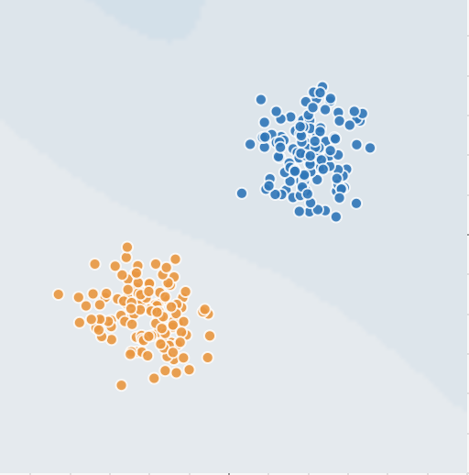
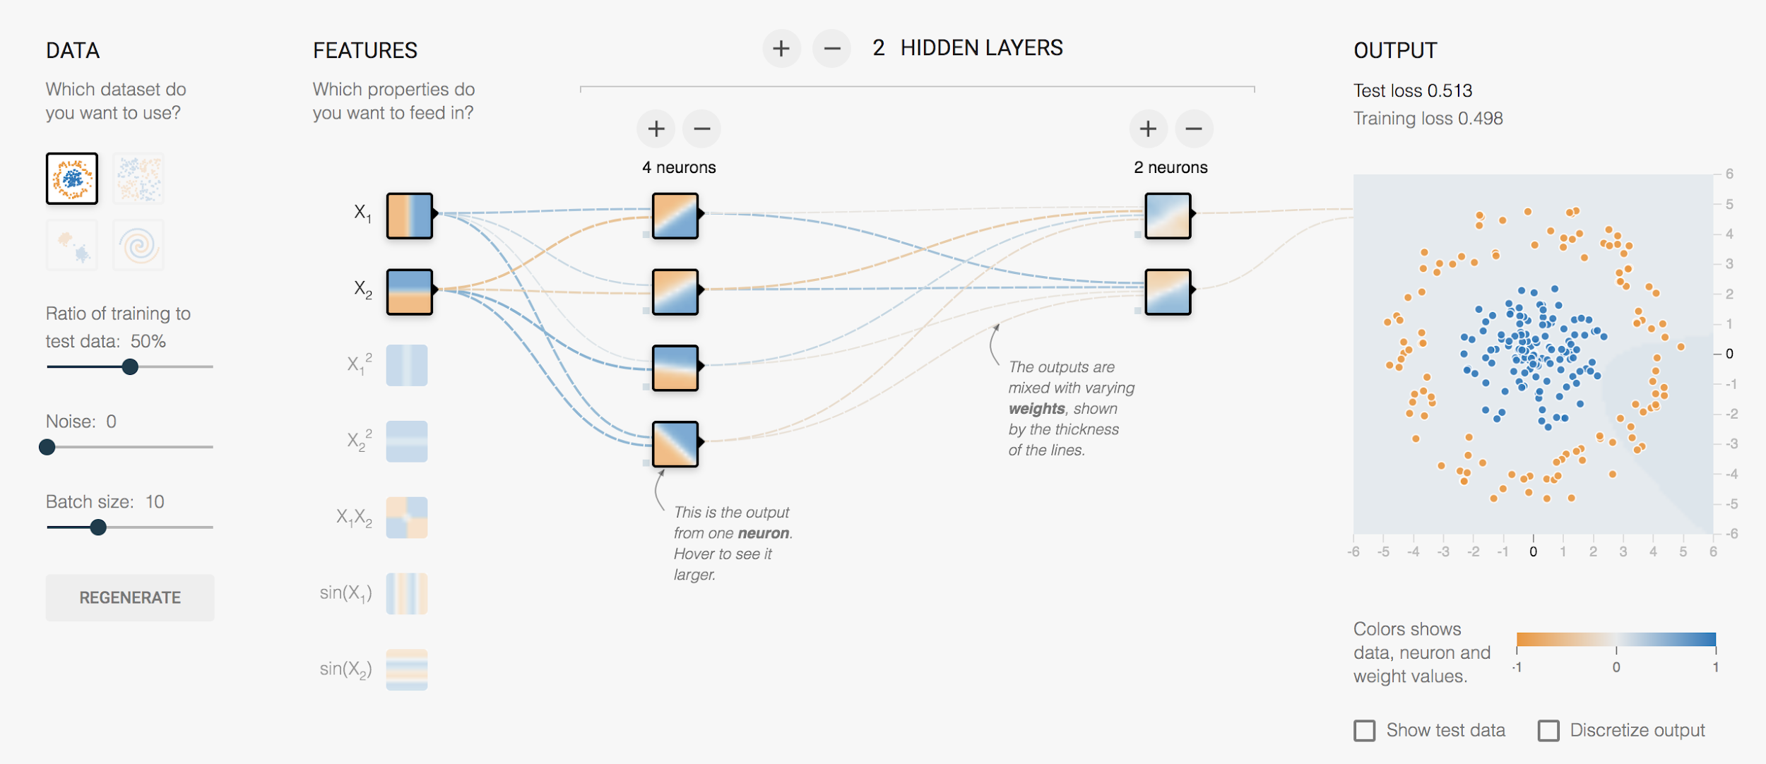
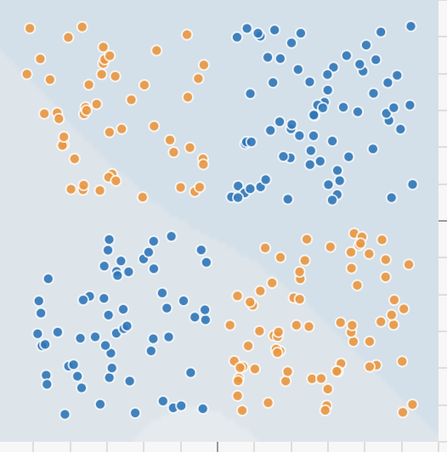

Google’s Neural Network Playground
https://www.playground.tensorflow.org/

Slide 5
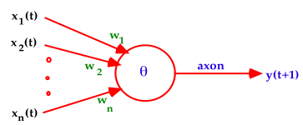
Warren McCulloch and Walter Pitts (1943)
A McCulloch-Pitts neuron operates on a discrete time-scale, t = 0,1,2,3, ... with time tick equal to one refractory period
At each time step, an input or output is
on or off — 1 or 0, respectively.
Each connection or synapse from the output of one neuron to the input of another, has an attached weight.

Slide 6
From Logical Neurons to Finite Automata
X₁
1
Brains, Machines, and
Mathematics, 2nd ed, 1987
AND
1.5
X₂
1
Boolean Net
X₁
1
→
Y
X Y
0.5
OR
1
X₂
NOT
X
X
0
Y
Finite
-1
Automaton
Y
Q
Hopfield Units

Slide 7
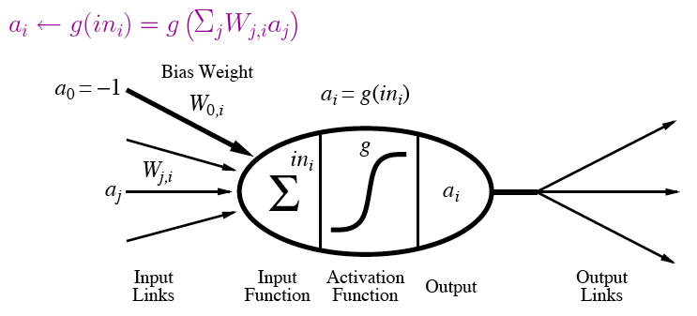
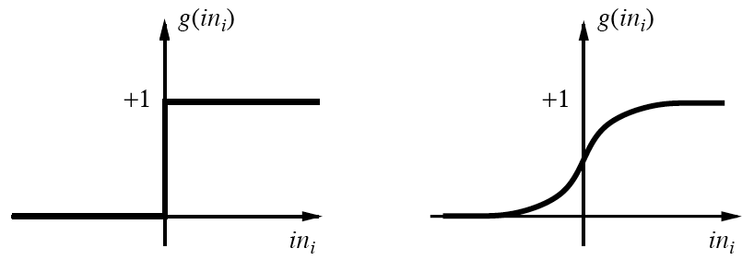
A modern variation of “Units”
Output is a “squashed” linear function of inputs:
Activation function can be step/threshold or sigmoid
Bias weight sets threshold for linear threshold unit

Slide 8
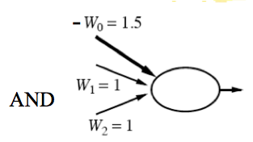
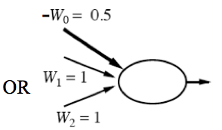
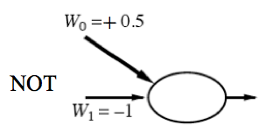
Implementing Logical Functions
Any Boolean function can be implemented in a network of linear threshold units (perceptrons)
But single layer networks are limited
E.g., cannot compute XOR
Minsky & Papert essentially killed off neural network field for a decade by showing this in 1969
Bias weight
Bias weight
Bias weight
Notes:
Ws are weights on inputs, not inputs.
Add all weighted inputs and see if >0

Slide 9
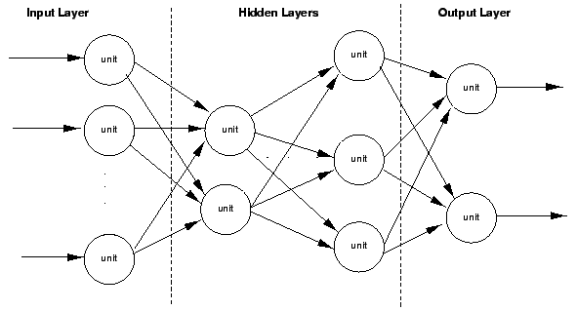
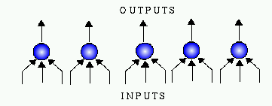
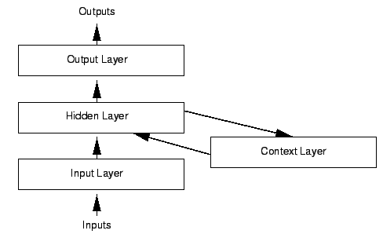
Variety of Network Structures
Feed-forward networks
May be single- or multi-layer
Implement functions/reflexes
No internal state
Recurrent networks
Directed cycles with delays
Internal state, like flip-flops
Dynamical systems
Hopfield networks
LTUs w/ symmetric weights
Minimize overall energy
Boltzmann machines
Stochastic, simulated annealing

Slide 10
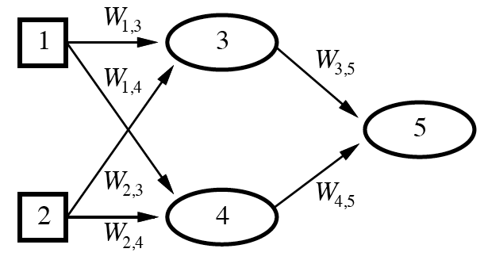
Feed-Forward Example
Feed-forward networks provide a parameterized family of nonlinear functions
a₅ = g(W_{3,5}a₃ + W_{4,5}a₄)
=g(W_{3,5}g(W_{1,3}a₁+W_{2,3}a₂) + W_{4,5}g(W_{1,4}a₁+W_{2,4}a₂))
Learning occurs by adjusting weights

Slide 11
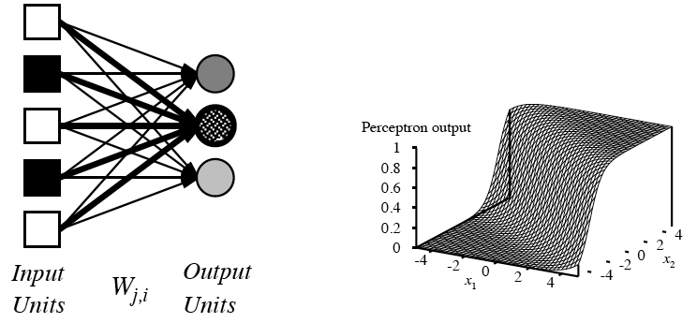
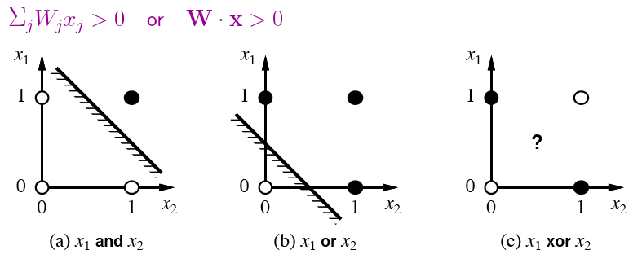
Single-Layer Perceptrons
Each output unit operates separately
Implements a linear separator
Adjusting weights alters location, orientation, and steepness of cliff

Slide 12
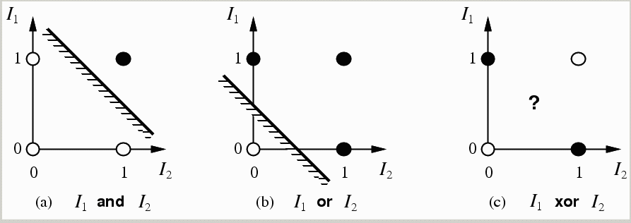
limitations of a single layer perceptron and linear separability problem
a single layer perceptron can only represent linearly separable functions which follows from the inequalities that determine its firing (Minsky & Papert(1969))
y(t+1) = 1 if and only if Σ w_{i}x_{i}(t) ≥ θ else y(t+1) = 0
i.e. input space is divided in 2

Slide 13
Perceptron Learning
Learn by adjusting weights on each iteration to reduce error
Gradient descent on squared error (y – out ) ²
Update rule for weights of a threshold function:
W_{j}’ = W_{j} + α (y – out ) x_{j}
Comparable rules exist for differentiable activation functions
This perceptron learning rule is guaranteed to converge to a consistent function if the data is linearly separable
x₁
y
W₁
x₂
out
W₂
x₃
W₃
Notes:
y is the correct value on example x
out is the output of the neuron on example x
α is the learning rate
x_{j} is the value of the jth input to x (only modify weight if it actually contributed)
Modify weight according to the degree of error

Slide 14
Majority Function
Output 1 if and only if > ½ of n binary variables are 1
Representable within a perceptron
w_{i} = 1
w₀ = −(n ∕ 2)
o = 1 if and only if a₁+a₂+...+a_{n} − (n ∕ 2) ≥ 0
Compare to a decision tree needs an exponential number of branches
One branch for each combination with a majority of Trues
e.g., IF a₁=1 AND a₂=1 AND… a_{n/2}=1 AND a_{n/2+1}=1 THEN 1
ELSE IF a₁=0 AND a₂=1 AND… a_{n/2+1}=1 AND a_{n/2+2}=1 THEN 1

Slide 15
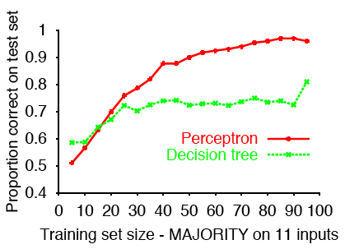
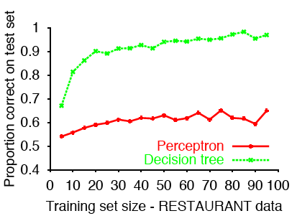
Sample Results
Perceptron learns majority function easily; DTL hopeless
Linearly separable, but difficult to express with yes/no splits on attributes without a path for each combination of attributes that would yield a majority
DTL learns restaurant function easily; single layer perceptron can’t represent it
Data came from a decision tree
Data is not linearly separable
( )
11
6

Slide 16
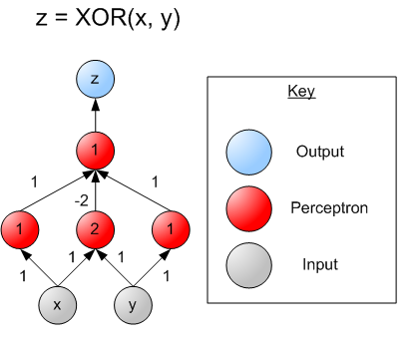
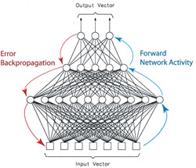
Multi-layer Perceptrons
single layer perceptrons can only represent linear decision surfaces
multi-layer perceptrons can represent non-linear decision surfaces.

Slide 17
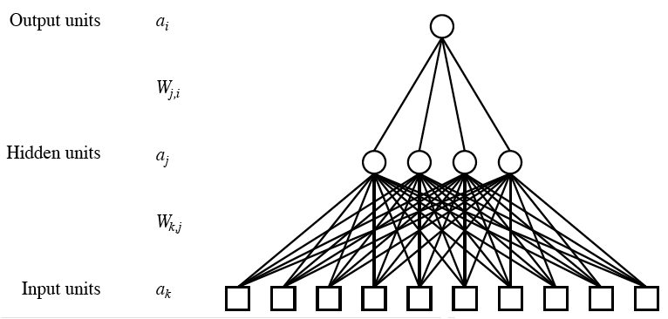
Multilayer Neural Networks
Units typically fully connected across layers unless have domain-specific knowledge to guide
Number of hidden units either chosen by hand or found via search
If too many, network will memorize input (overfitting)
If too few, function will be difficult to represent
As with Goldilocks, need it just right (to generalize)

Slide 18
Back-Propagation (learning) David E Rumelhart, Geoffrey E Hinton, and Ronald J Williams. Learning representations by back-propagating errors. Nature, 323(9) 533-536 1986. www.cs.toronto.edu/hinton/absps/naturebp.pdf.

Slide 19
Learn by Back-Propagation
Challenges for learning in networks with hidden units
Can’t directly compute error on output of hidden units because don’t have the true values for them
Also a clustering problem/opportunity
May yield new useful features
General approach is to (re)apportion error on output units to predecessors based on the weight of their connection, and continue this recursively backwards through the network

Slide 20
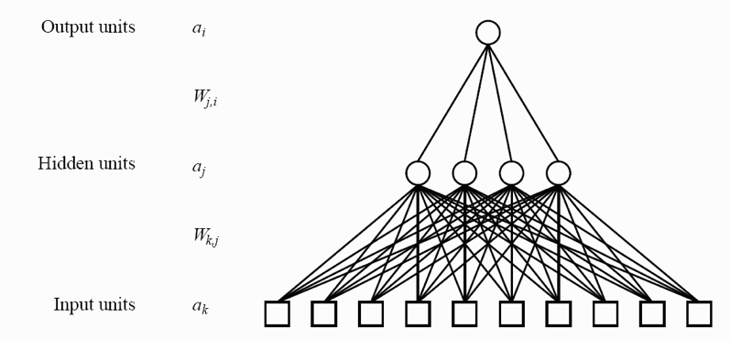
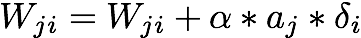
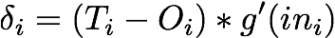
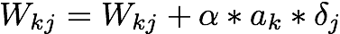
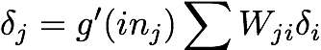
Training a multilayer network using Backpropagation

Slide 21
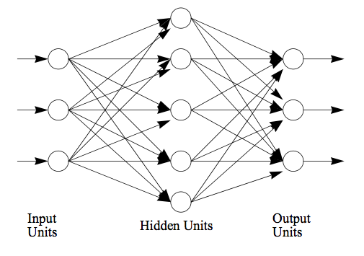
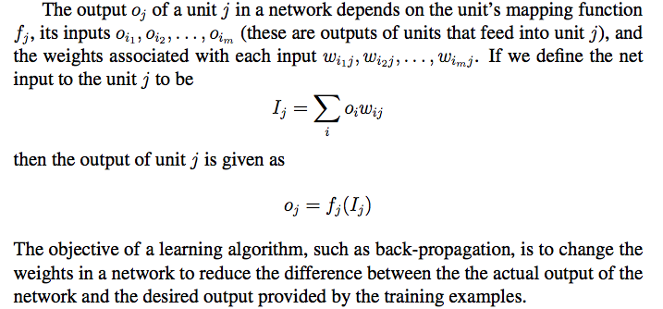
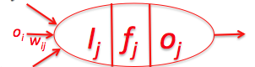
Neural Networks (The back-propagation math) (WS Chapter 4)

Slide 22
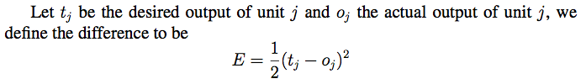
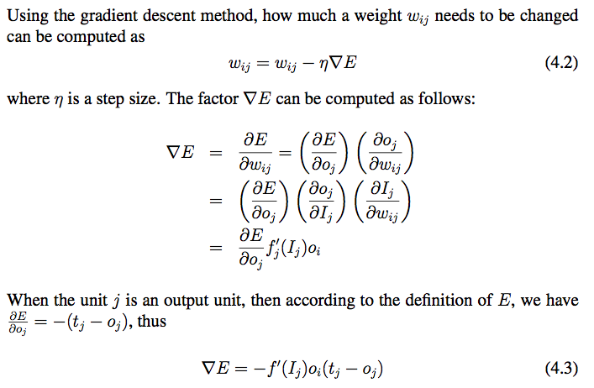
Back-Propagation (1/3)
i
j

Slide 23
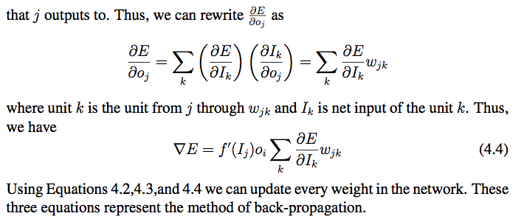
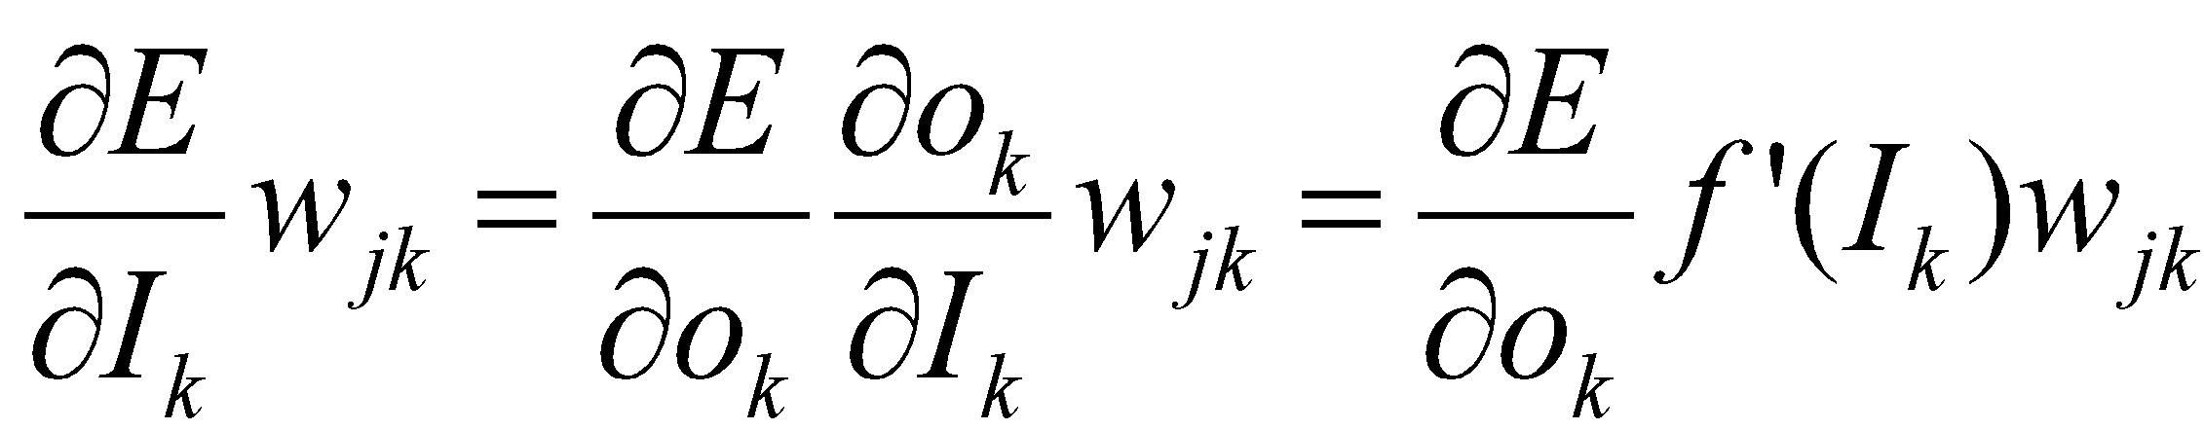
Back-Propagation (2/3)
j
k
i
, where

Slide 24

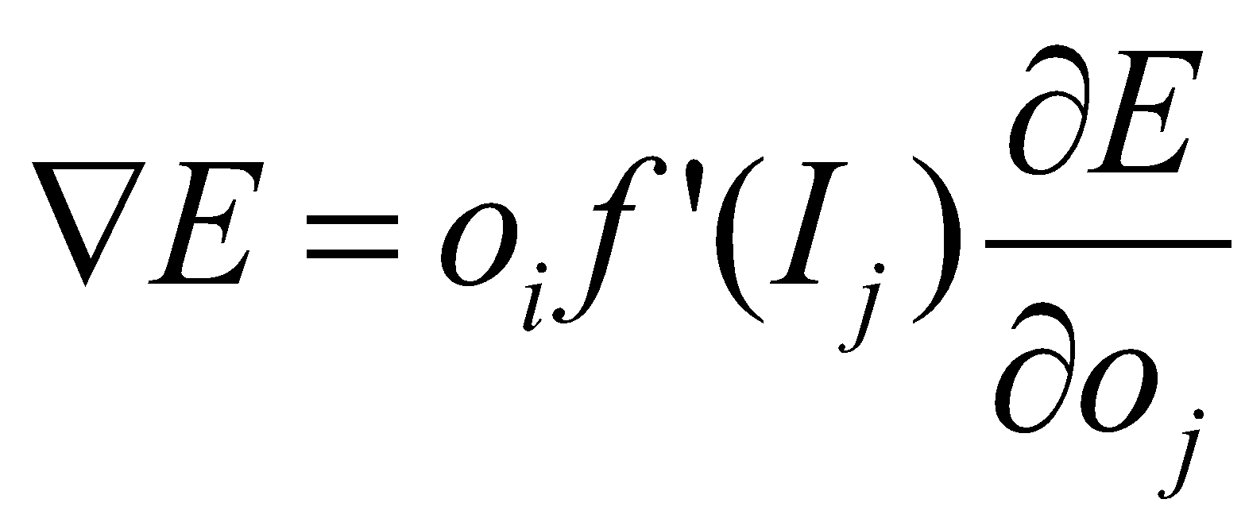
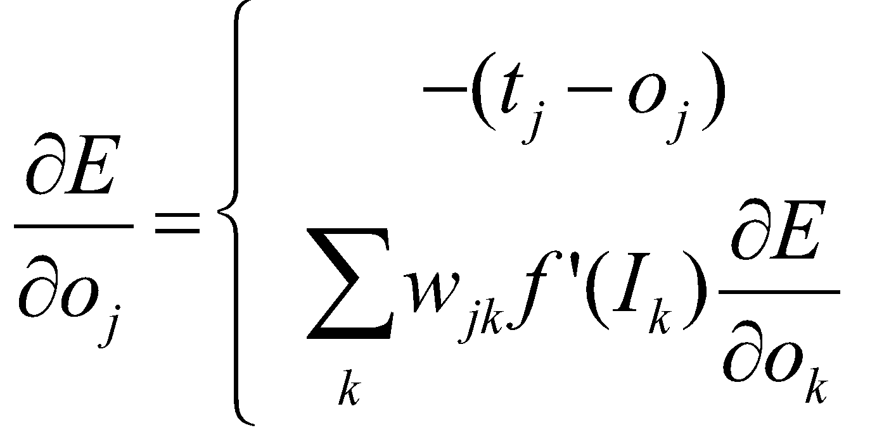
Back-Propagation (3/3)
Summery: change a link weight from unit i to j using these formulas:
i
j
When j is an output unit
When j is not an output unit
j
k
i

Slide 25
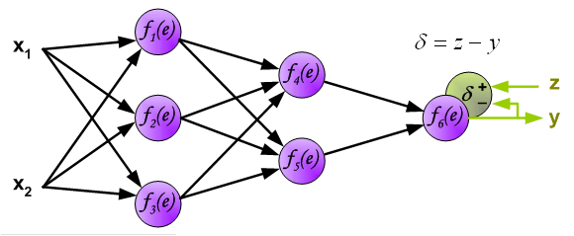
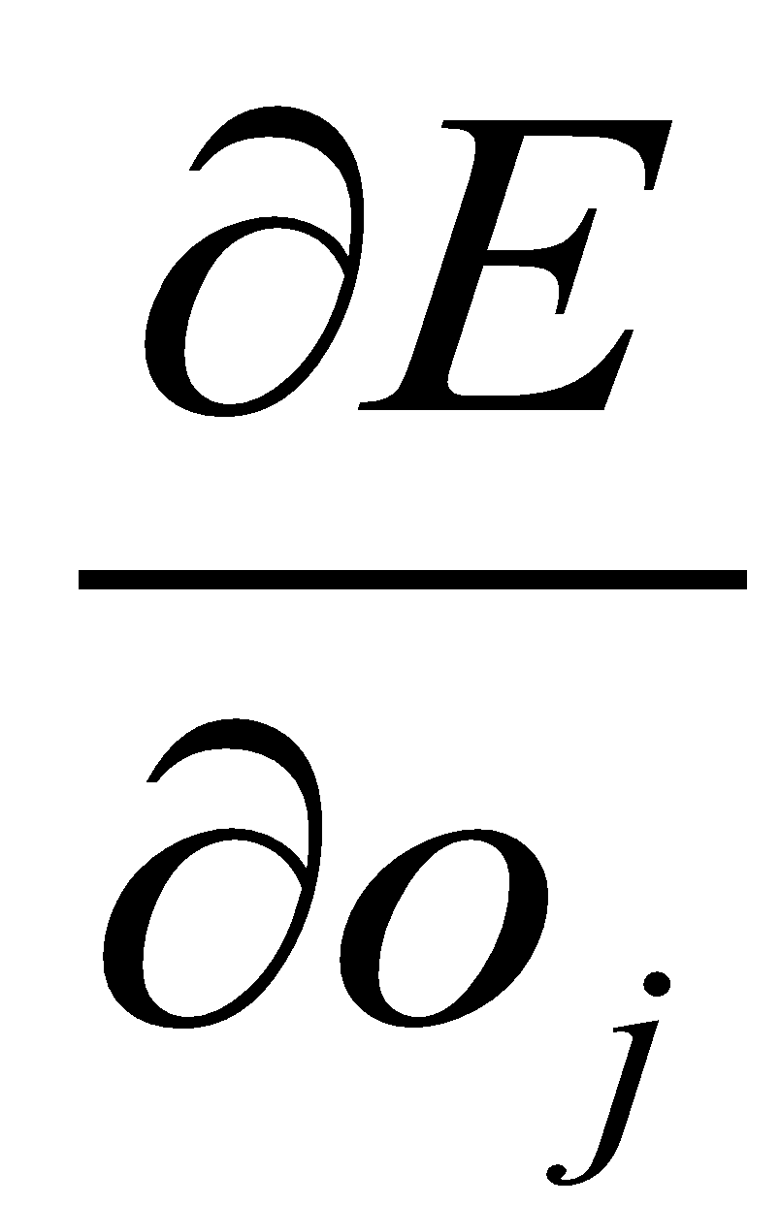
Example of Back-propagation
Note: δ here is equivalent to in the previous slides,
and assuming f ’(e) = 1.0.

Slide 26
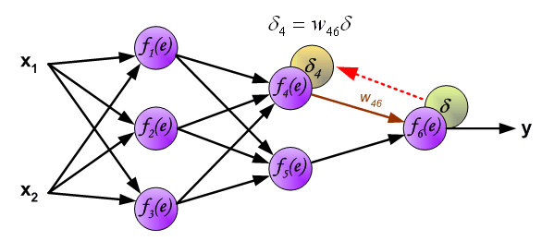
Example of Back-propagation

Slide 27
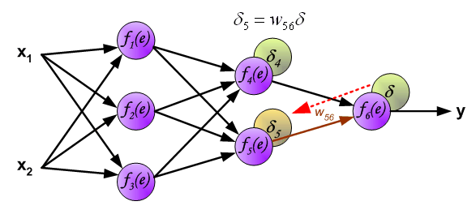
Example of Back-propagation

Slide 28
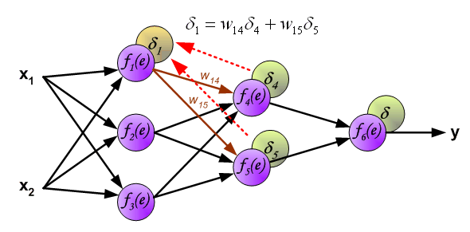
Example of Back-propagation

Slide 29
Some Comments on NNs So Far
Multi-layer networks can overcome the representational limitations of single-layer
Although may have issues with local minima
Recurrent networks are even more powerful, but more complex to understand and work with
Most common applications are in continuous perceptual or perceptuomotor domains
E.g., speech, driving, handwriting, fraud detection
Recently have been efforts to understand relationship between NN and Bayesian learning

Slide 30
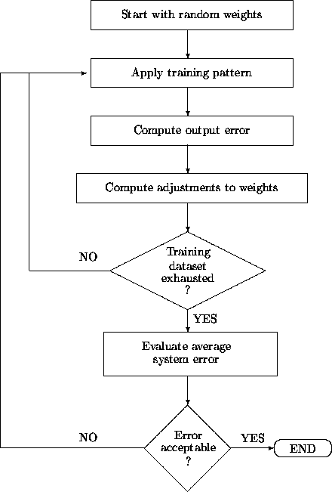
Training a Multilayer Network
prediction
Back propagation

Slide 31
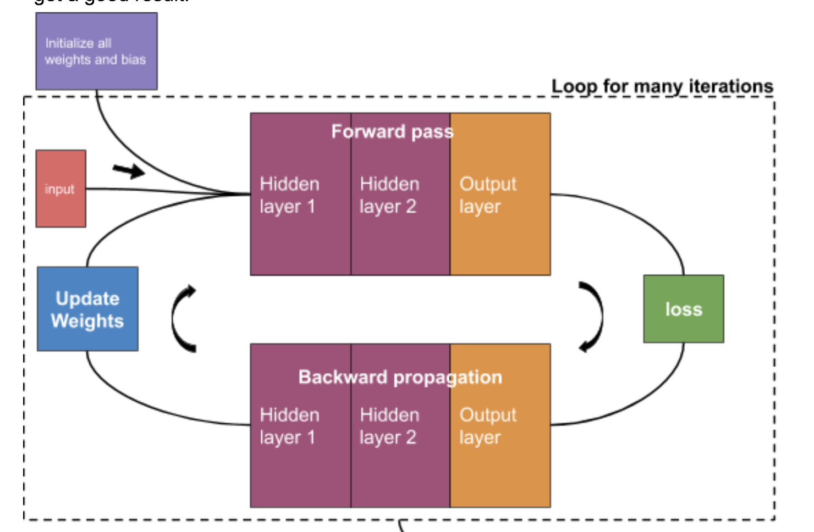

Slide 32
Face Recognition (Example)

Slide 33
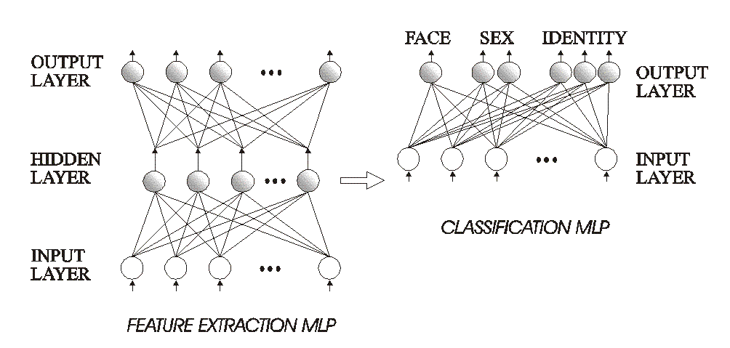
Example: Face Recognition
Using the 2-stage approach (feature extraction + Classification)

Slide 34
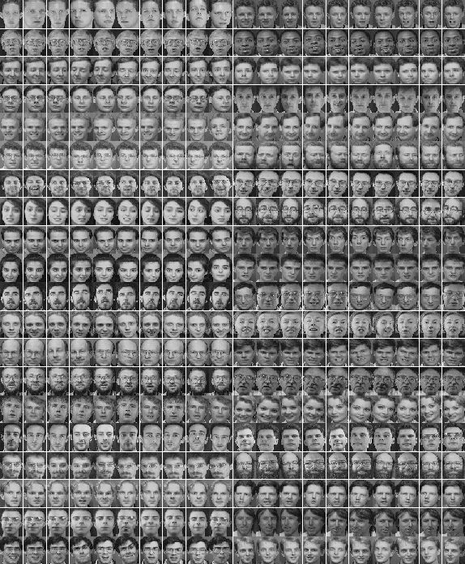
Training Data

Slide 35
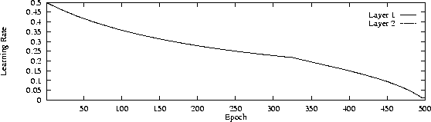
Learning Rate

Slide 36
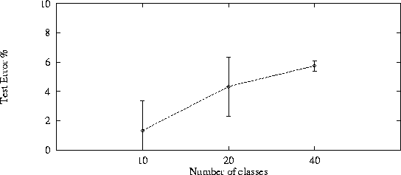
Testing / Evaluation
Look at performance as a function of network complexity

Slide 37
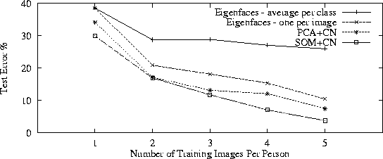
Testing / Evaluation
Comparison with other known techniques

Slide 38
Learning from a Blackbox Using NN
Training data: more than >2 attributes
Multiple Classes: more than binary class
Design your neural networks
Choose the number of hidden layers and hidden nodes
Training your neural networks
Implement the Backpropagation algorithm
Select the number of epochs and your learning rate
You can divide your training set into “batches” to train your NN

Slide 39
Google’s Neural Network Playground
https://www.playground.tensorflow.org/

Slide 40
Modeling the Brain

Slide 41
General Comments: Artificial Neural Networks
Artificial Neural Networks provide…
A new computing paradigm
A technique for developing trainable classifiers, memories, dimension-reducing mappings, etc
A tool to study brain functions

Slide 42
Converging Frameworks
Artificial intelligence (AI): build a “packet of intelligence” into a machine
Cognitive psychology: explain human behavior by interacting processes (schemas) “in the head” but not localized in the brain
Brain Theory: interactions of components of the brain -
- computational neuroscience
- neurologically constrained-models
and abstracting from them as both Artificial intelligence and Cognitive psychology:
- connectionism: networks of trainable “quasi-neurons” to provide “parallel distributed models” little constrained by neurophysiology
- abstract (computer program or control system) information processing models

Slide 43


CS 561, Session 20

Slide 44

Major Functional Areas
Primary motor: voluntary movement
Primary somatosensory: tactile, pain, pressure, position, temp., mvt.
Motor association: coordination of complex movements
Sensory association: processing of multisensory information
Prefrontal: planning, emotion, judgement
Speech center (Broca’s area): speech production and articulation
Wernicke’s area: comprehen-
sion of speech
Auditory: hearing
Auditory association: complex
auditory processing
Visual: low-level vision
Visual association: higher-level
vision

Slide 45

Interconnect
Felleman & Van Essen, 1991
CS 561, Session 20

Slide 46

Remember? Neurons & synapses
Key terms:
Axon
Dendrites
Synapses
Soma (cell body)

Slide 47

Electron Micrograph of a Real Neuron

Slide 48
Approaches to Neural Modeling
Biologically-realistic, detailed models
E.g., cable equation, multi-compartment models
The Hodgkin-Huxley model
Simulators like NEURON (Yale) or GENESIS (Caltech)
More abstract models, still keeping realism in mind
E.g., integrate & fire model, simple and low detail but preserves spiking behavior
Highly abstract models, neurons as operators
E.g., McCulloch & Pitts model
Classical “neural nets” modeling

Slide 49


Detailed Neural Modeling
A simulator, called “Neuron” has been developed at Yale to simulate the Hodgkin-Huxley equations, as well as other membranes/channels/etc. See http://www.neuron.yale.edu/

Slide 50

Detailed Neural Modeling
https://www.youtube.com/watch?v=HYLyhXRp298
CS 561, Session 19

Slide 51

The Cable Equation
See http://diwww.epfl.ch/~gerstner/SPNM/SPNM.html
for excellent additional material (some reproduced here).
Just a piece of passive dendrite can yield complicated differential equations which have been extensively studied by electronicians in the context of the study of coaxial cables (TV antenna cable):

Slide 52


The Hodgkin-Huxley Model
Example spike trains obtained…

Slide 53

Leaky Integrator Neuron
The simplest "realistic" neuron model is a continuous time model based on using the firing rate (e.g., the number of spikes traversing the axon in the most recent 20 msec.) as a continuously varying measure of the cell's activity
The state of the neuron is described by a single variable, the membrane potential.
The firing rate is approximated by a sigmoid, function of membrane potential.

Slide 54
Leaky Integrator Model
m(t)
τ = - m(t) + h
has solution m(t) = e^{-t/τ} m(0) + (1 - e^{-t/τ})h
→ h for time constant τ > 0.
We now add synaptic inputs to get the
Leaky Integrator Model:
τ = - m(t) + Σ _{i} w_{i} X_{i}(t) + h
where X_{i}(t) is the firing rate at the i^{th} input.
Excitatory input (w_{i} > 0) will increase
Inhibitory input (w_{i} < 0) will have the opposite effect.
X(t) = g(m(t)) with g() a sigmoid relates output to membrane potential
m(t)
m(t)

Slide 55

The “Basic” Biological Neuron
The soma and dendrites act as the input surface; the axon carries the outputs.
The tips of the branches of the axon form synapses upon other neurons or upon effectors (though synapses may occur along the branches of an axon as well as the ends). The arrows indicate the direction of "typical" information flow from inputs to outputs.

Slide 56

Vision, AI and ANNs
1940s: beginning of Artificial Neural Networks
McCullogh & Pitts, 1942
Σ_{i} w_{i}x_{i} ≥ θ
Perceptron learning rule (Rosenblatt, 1962)
Backpropagation
Hopfield networks (1982)
Kohonen self-organizing maps
…

Slide 57
Excitatory and Inhibitory Synapses
We call a synapse
excitatory if w_{i} > 0, and
inhibitory if w_{i} < 0.
We also associate a threshold θ with each neuron
A neuron fires (i.e., has value 1 on its output line) at time t+1 if the weighted sum of inputs at t reaches or passes θ:
y(t+1) = 1 if and only if Σ w_{i}x_{i}(t) ≥ θ

Slide 58
Increasing the Realism of Neuron Models
The McCulloch-Pitts neuron of 1943 is important
as a basis for
logical analysis of the neurally computable, and
current design of some neural devices (especially when augmented by learning rules to adjust synaptic weights).
However, it is no longer considered a useful model for making contact with neurophysiological data concerning real neurons.

Slide 59


Deep Neural Networks
ImageNet visual recognition
challenge: recognize objects,
animals, people, etc (200 categories)
in photographs.
CS 561, Session 20

Slide 60

Deep Neural Networks
Top performers for the 2014 challenge (including winner) are deep neural networks!
CS 561, Session 20

Slide 61

Deep Neural Networks
Very deep layered network (27 layers) with hundreds of millions of parameters.
Trained on very large datasets at Google.

Slide 62
Deep Learning
Multilayer neural networks are one form
Train each layer as if it were a standalone neural network
A hierarchy of loosely connected learning systems
Basic principles are the same as what you’ve learned
But with newer methods for dealing with larger data sets
Finding representations and structures similar to the brain’s
e.g., for facial recognition
And exploiting steady increases in computing power

Slide 63

Scene Understanding

Slide 64
Deep Learning
Train each layer as if it were standalone
Train a neural network to identify the road
Train a neural network to identify a car
Train a neural network to identify a truck
…
A hierarchy of loosely connected learning systems
Train a neural network to identify a clear / busy / unsafe road

Slide 65
Applications

Slide 66
Applications: Classification
Business
Credit rating and risk assessment
Insurance risk evaluation
Fraud detection
Insider dealing detection
Marketing analysis
Mailshot profiling
Signature verification
Inventory control
Security
Face recognition
Speaker verification
Fingerprint analysis
Medicine
General diagnosis
Detection of heart defects
Engineering
Machinery defect diagnosis
Signal processing
Character recognition
Process supervision
Process fault analysis
Speech recognition
Machine vision
Speech recognition
Radar signal classification
Science
Recognising genes
Botanical classification
Bacteria identification

Slide 67
Applications: Modelling
Business
Prediction of share and commodity prices
Prediction of economic indicators
Insider dealing detection
Marketing analysis
Mailshot profiling
Signature verification
Inventory control
Engineering
Transducer linerisation
Colour discrimination
Robot control and navigation
Process control
Aircraft landing control
Car active suspension control
Printed Circuit auto routing
Integrated circuit layout
Image compression
Science
Prediction of the performance of drugs from the molecular structure
Weather prediction
Sunspot prediction
Medicine
. Medical imaging and image processing

Slide 68
Applicationsh: Forecasting and Detection
Forecasting:
Future sales
Production Requirements
Market Performance
Economic Indicators
Energy Requirements
Time Based Variables
Novelty Detection:
Fault Monitoring
Performance Monitoring
Fraud Detection
Detecting Rate Features
Different Cases

